Slide 1
Key words of chapter 29
Law of Biot and Savart 毕奥萨法尔定律
Ampere’s Law 安培定理
Long Straight Wire 长直导线
Circular Arc 圆弧
Solenoids 直螺线管
Toroids 环形螺线管
Crooked wire 弯曲导线
Amperian loop 安培回路

Slide 2
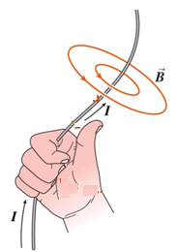
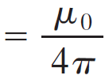

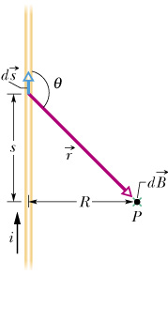
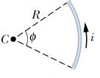
Review of Ch29 Biot-Savart law
Right-hand rule
x r
dB =
.
Notes:
BS law describes the B field produced by a current length element, here ds is the length differential whose direction is the direction of current, r is the distance between point p and length element, and r hat is a unit vector pointing from ds to P, so the direction of B is into the paper at this case. We also can use right hand rule to determine the direction of B field. Use your right hand, Grasp the element with your thumb pointing in the direction of the current, your four fingers then curl around the direction of the B field.
a circular arc carrying current I produce a B field around it, and we want to find the B field at the center of the arc. So we use BS law, here we choose a current length element ds, then this is r, r=R, and r hat cross ds, just out of paper, and the angle theta is 90 degree, so we have, then do a sum for all the B field produced by each element, that is integration, from 0 to pha. Then we get the B field at the center of the arc.

Slide 3
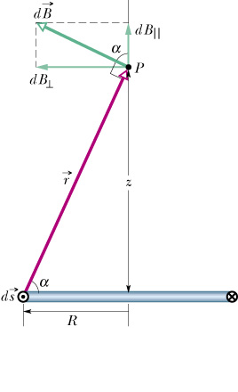

Review of Ch29 Biot-Savart law--circular Loop
P
R

Slide 4
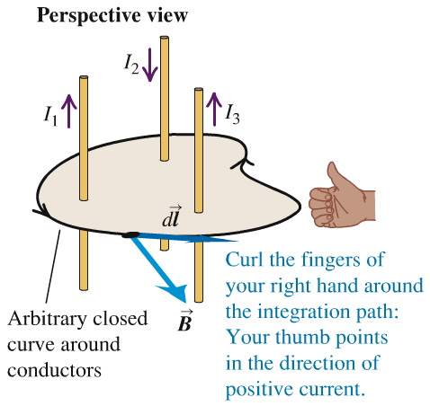
Review of Ch29 Ampere's law
Currents are steady
No magnetic materials are present
No time-varying E-fields are present
Notes:
Ampere’s law is very important, and it’s convenient to evaluate B field if the current distribution has a good symmetry.
First we choose the current distribution as our target, and then we choose a closed loop, and dl is the path differential of this loop, B is the magnetic field produced by the chosen current distribution, and this circle indicate we do the intergradation along the closed loop, and I encircled is the net current encircled by the this closed.
This close loop define a positive direction, grasp the loop by your right hand with your four fingers pointing to the loop direction, then your thumb points to the positive current direction. in this figure, I1 and I3 are positive, and I2 negative, so--.

Slide 5
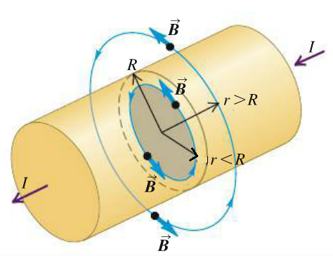
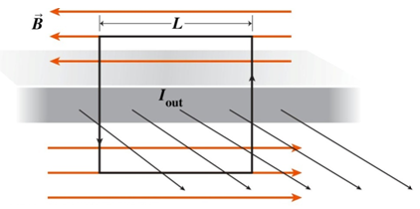

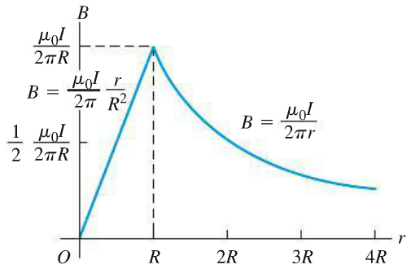

Review of Ch29 Ampere's law
A long Current Cylinder
A Large Current Sheet
with uniform current density J_{S}
B is // to sheet & ⊥ I_{out}
Notes:
A long cylindrical current distribution has a good cylindrical symmetry, if we rotate the cylinder about its central axis, the current distribution dose not change, so the B field does not change, so we know, along a concentric circle, the magnitude of B field must be same. The magnitude of B field only related by the perpendicular distance r from the center axis. the B field line form a circle, so B must point to the tangential direction of the circle. So we can choose a proper loop according to the property of the B field and then use ampere’s law to find the value of it.
A concentric circle is a good choice, then ------
For a large current sheet, with a uniform current density, first we analyze the property of B field, this sheet can be considered as a combination of straight current wires, each current wire produce a B field like this, then for the adjacent two wires, the vertical component cancel each other, so B field near the surface must be along the horizontal direction, like this, then we can choose a rectangle as our ampere’s loop,

Slide 6
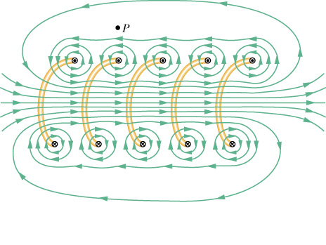
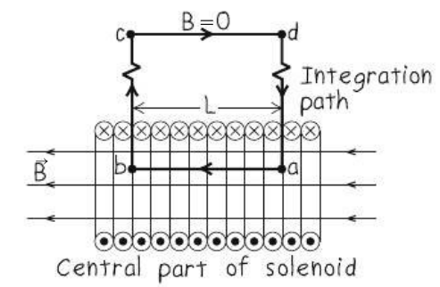
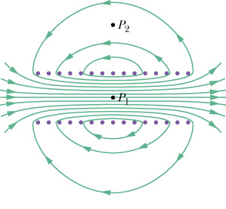

Review of Ch29 Ampere's law--solenoid
Coil length is much longer than the coil diameter
B-field is uniform inside the solenoid and zero outside
Notes:
For the ideal solenoid, the B field distribution like this, inside, along the longitudinal direction, because it’s a long solenoid, each point you can think as the center of the solenoid, so B field must be same along this direction, outside, almost 0, so we choose this loop, let the path parallel to the B field or perpendicular to B, like this ,then we have:

Slide 7
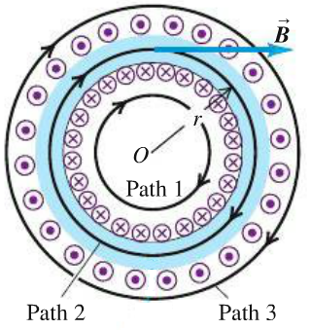
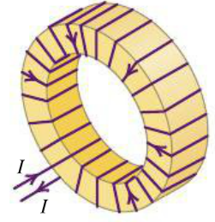

Review of Ch29 Ampere's law--toroid
Cylindrical symmetry:
Path 1 : no current enclosed, B = 0
Path 3 : net current enclosed is zero, B = 0
Path 2 :
Notes:
Cylindrical symmetry, so the magnitude of B field only related by the distance r from center, and along tangential direction, so we choose concentric circle as the ampere’s loop
Then we have:

Slide 8
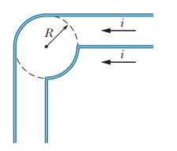
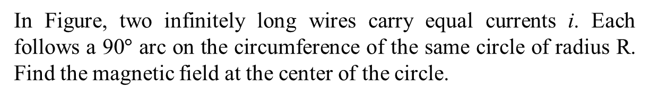
Problem 1 of Ch29

Slide 9
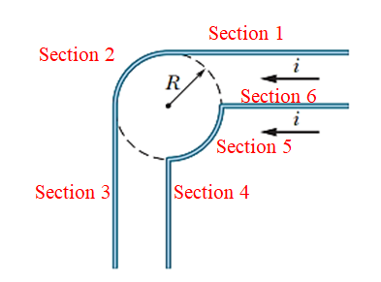
Solution 1 of Ch29
We refer to the center of the circle as C. we see that:
the current in the straight segments that are collinear with C (the section 4 and section 6) do not contribute to the field there.
The right-hand rule indicates that the currents in the two arcs (section 2 and section 5) contribute to the field at C:
Thus, the nonzero contributions come from those straight segments that are not collinear with C (section 1 and section 3). Both contribute fields pointing out of the page according to the right hand rule. For a “semi-infinite” current carrying wire, from the symmetry, we know the magnetic field is exactly half of B field due to the infinite long one. We can apply Ampere’s law to get the B field created by infinite long current carrying wire, that is:
So we get the net field is:
direction: out of page

Slide 10
Problem 2 of Ch29
The current density J inside a long, solid, cylindrical wire of radius a = 3.1mm is in the direction of the central axis, and its magnitude varies linearly with radial distance r from the axis according to J = J₀r/a, where J₀ = 310 A/m². Find the magnitude of the magnetic field at following position:
(a) r = 0
(b) r = a/2
(c) r = a
(d) r = 4a
Notes:
It’s a cylindrical wire with J only related by radius r, so it indeed has cylindrical symmetry, so we know the B field must have same magnitude along a concentric circle, so we choose a concentric circle through the point at which we want to evaluate its B field as ampere’s loop, and then write ampere’s law, calculate the right hand and the left hand, then we can figure out B field.

Slide 11
Problem 2 of Ch29
Cylindrical symmetry, Applying Ampere’s law inside the cylinder:

Slide 12
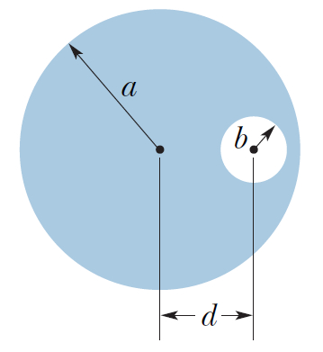
Problem 3 of Ch29
A cross section of a long cylindrical conductor of radius a = 4.00cm containing a long cylindrical hole of radius b = 1.50 cm. The central axes of the cylinder and hole are parallel and are distance d = 2.00 cm apart; current i = 5.25 A is uniformly distributed over the tinted area.
Find the magnitude of the magnetic field at the center of the hole
Find the magnetic field at any point in the hole.
Notes:
For the hollow cylinder, it has no cylindrical symmetry, so we can not use the ampere’s law directly to find B field produced by this current distribution.
But we can considered it as a combination of the two cylinders. A big

Slide 13
Problem 3 of Ch29
The total current in the region of the hole is zero
J_{b}
J_{a}

Slide 14
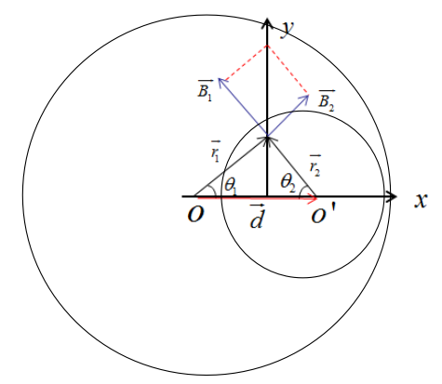
Problem 3 of Ch29
The magnetic field at a point within the hole is the sum of the B fields due to this two current distributions:
a) the magnitude of the B field at the center of the hole

Slide 15
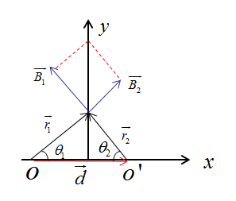
Problem 3 of Ch29
b) Any point in the hole
Conclusion: for the hollow cylinder, the B-field within the hollow is a constant

